Slide 1
Projective Rendering
Dr. Hamish Carr & Dr. Rafael Kuffner dos Anjos

Slide 2


Agenda
Vector maths for computer graphics
The synthetic camera.
Coordinate Systems
Projective pipeline
COMP 5812M: Foundations of Modelling & Rendering

Slide 3

What tools do we need?
Represent 3D things (points, lines, objects)
Transformations (move, scale, rotate, etc…)
Quick operations related to projection.
Not obvious now: useful when get more hands on.

Slide 4
Coordinate Systems
A coordinate system consists of:
an origin
(usually orthonormal) x,y,z vectors as axes
that usually obey the right-hand rule
which give rise to Cartesian coordinates
Points & vectors are (mostly) interchangeable
But their semantics differ

Slide 5
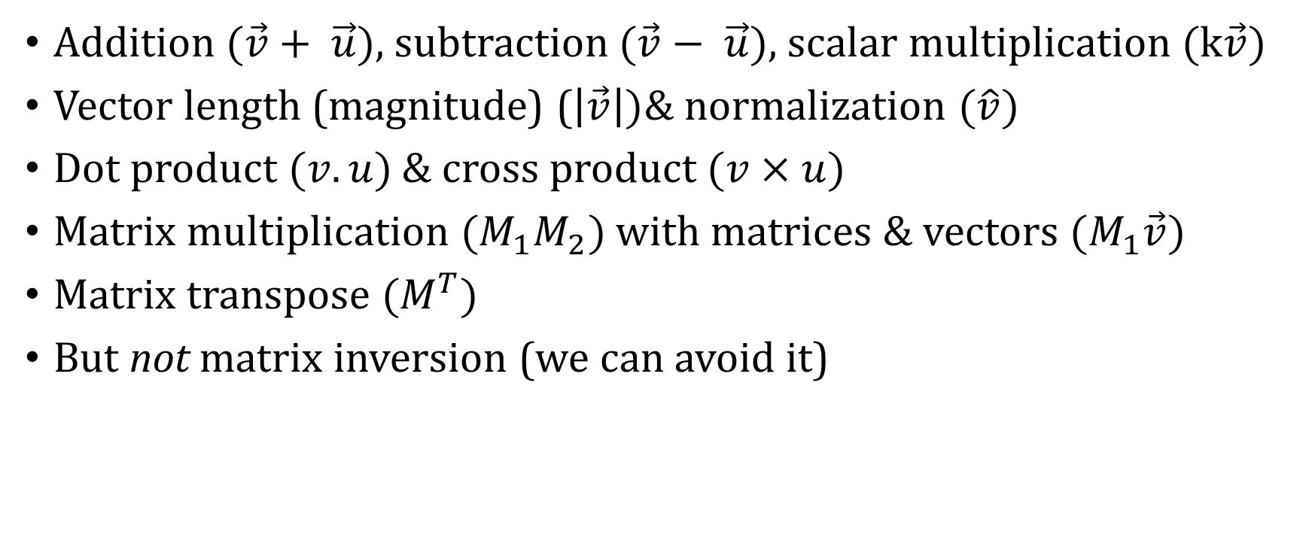
Vector Operations: basics recap
Addition $(\vec{v}+ \vec{u})$, subtraction $(\vec{v}− \vec{u})$, scalar multiplication $(k\vec{v})$
Vector length (magnitude) ($\left|\vec{v}\right|)$& normalization $(\hat{v})$
Dot product $(v.u)$& cross product $(v×u)$
Matrix multiplication $(M_{1}M_{2})$ with matrices & vectors $(M_{1}\vec{v})$
Matrix transpose $(M^{T})$
But not matrix inversion (we can avoid it)

Slide 6
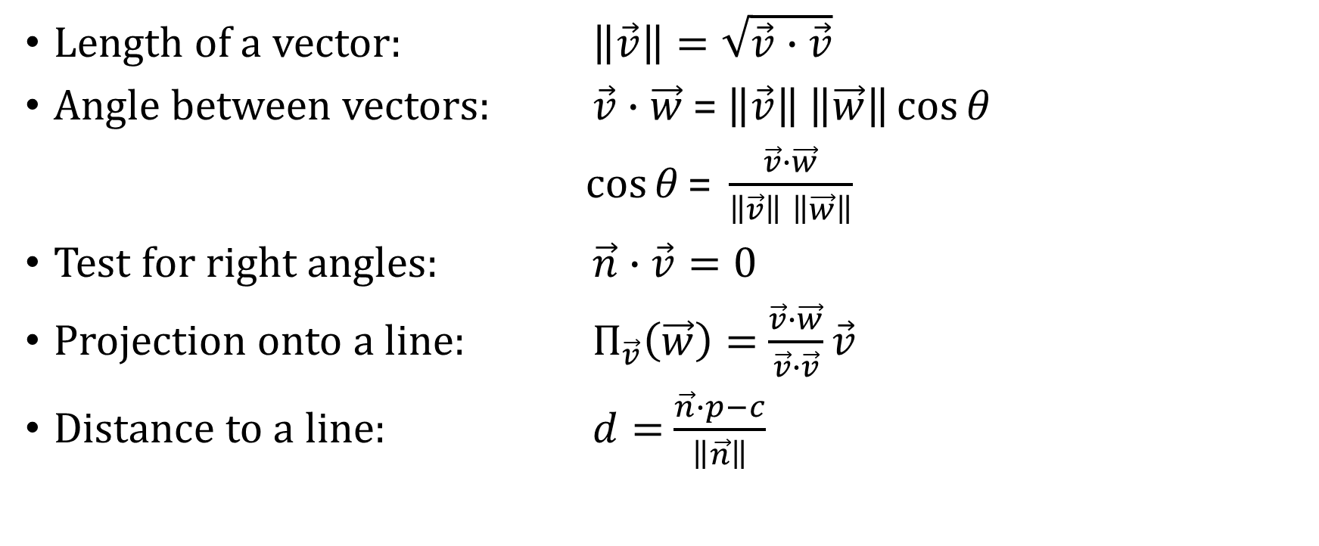
Dot Product: useful for several things!
Length of a vector: $\left\|\vec{v}\right\|=\sqrt{\vec{v}∙\vec{v}}$
Angle between vectors: $\vec{v}∙\vec{w}$ = $\left\|\vec{v}\right\|$ $\left\|\vec{w}\right\|\cos{θ}$
$\cos{θ}\text{= }\frac{\vec{v}∙\vec{w}}{\left\|\vec{v}\right\| \left\|\vec{w}\right\|}$
Test for right angles: $\vec{n}∙\vec{v}=0$
Projection onto a line: $Π_{\vec{v}}\left(\vec{w}\right)=$ $\frac{\vec{v}∙\vec{w}}{\vec{v}∙\vec{v}}\vec{v}$
Distance to a line: $d=$ $\frac{\vec{n}∙p−c}{\left\|\vec{n}\right\|}$

Slide 7
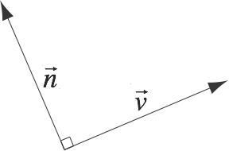
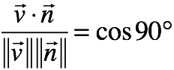
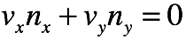
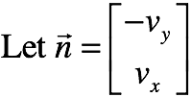
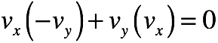
Normal Vectors
A normal vector is perpendicular to v

Slide 8
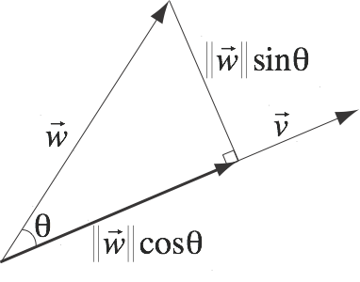
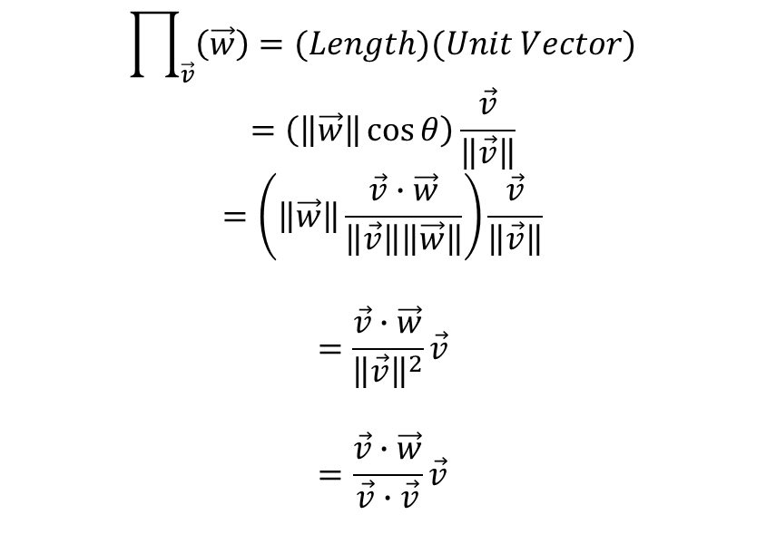
Projection
$$\prod_{\vec{v}}{\left(\vec{w}\right)=(Length)(Unit Vector)}$$
$$=\left(\left\|\vec{w}\right\|\cos{θ}\right)\frac{\vec{v}}{\left\|\vec{v}\right\|}$$
$$=\left(\left\|\vec{w}\right\|\frac{\vec{v}∙\vec{w}}{\left\|\vec{v}\right\|\left\|\vec{w}\right\|}\right)\frac{\vec{v}}{\left\|\vec{v}\right\|}$$
$$=\frac{\vec{v}∙\vec{w}}{{\left\|\vec{v}\right\|}^{2}}\vec{v}$$
$$=\frac{\vec{v}∙\vec{w}}{\vec{v}∙\vec{v}}\vec{v}$$

Slide 9
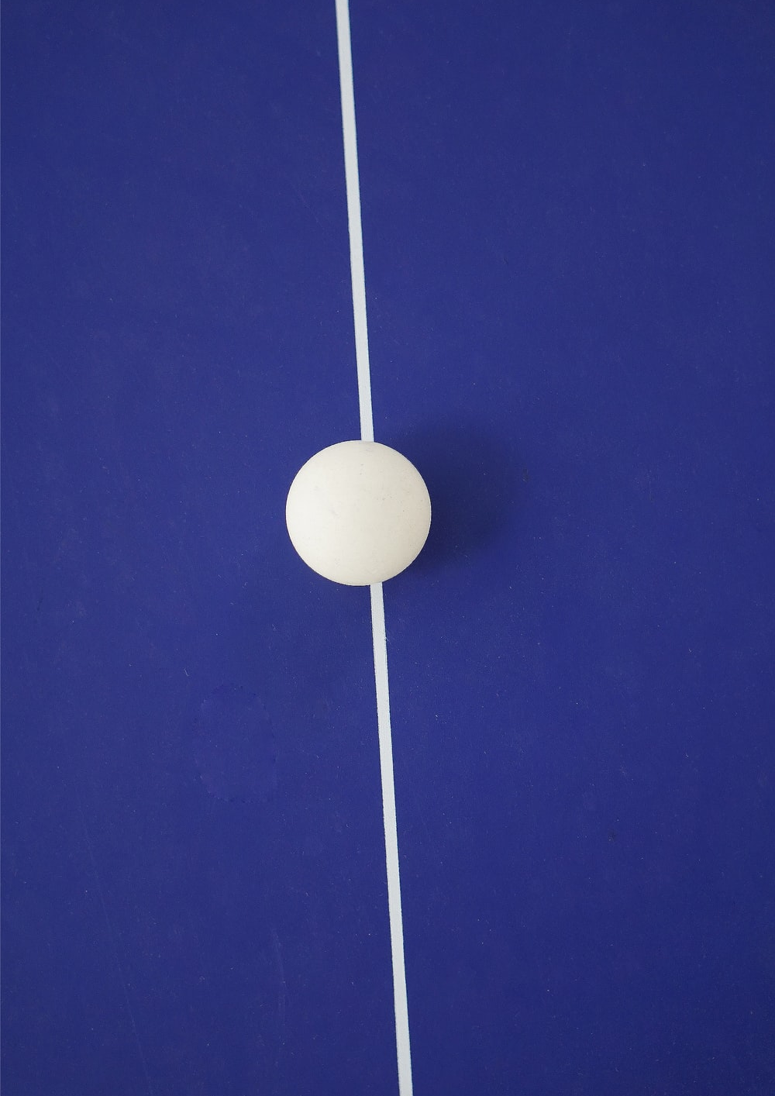
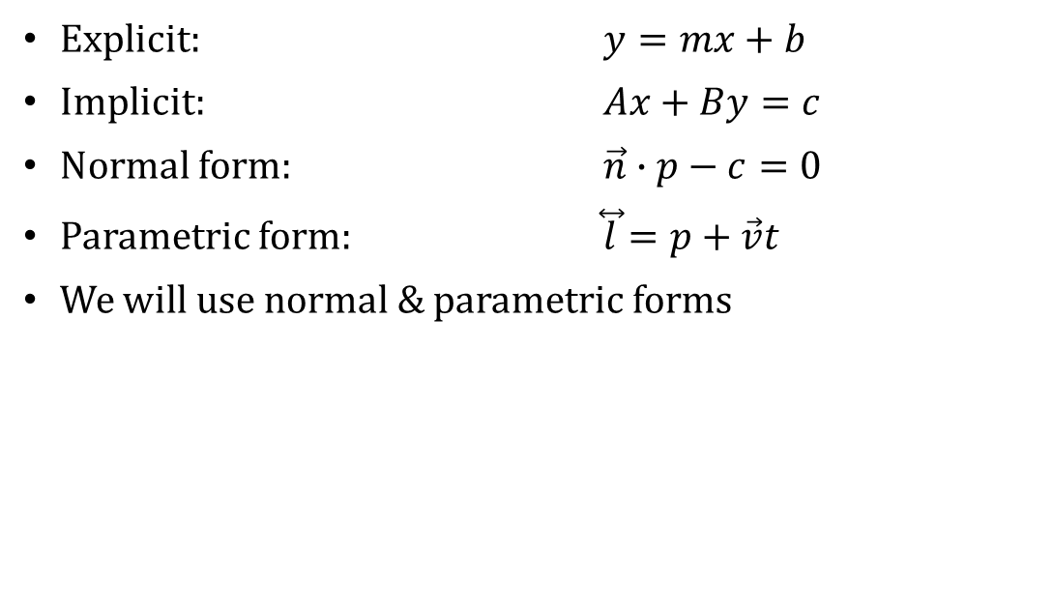
How can we represent a line?
Explicit: $y=mx+b$
Implicit: $Ax+By=c$
Normal form: $\vec{n}∙p−c=0$
Parametric form: $\overset{⃡}{l}=p+\vec{v}t$
We will use normal & parametric forms

Slide 10

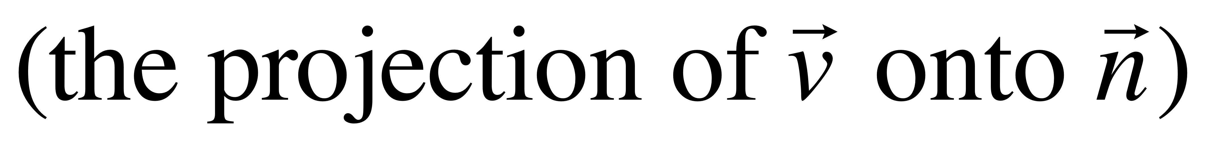
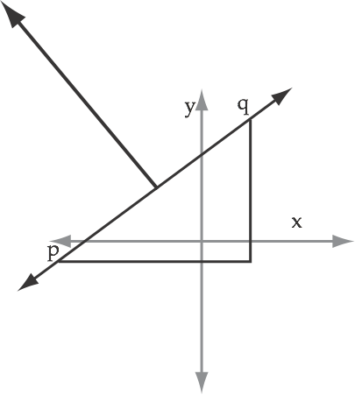
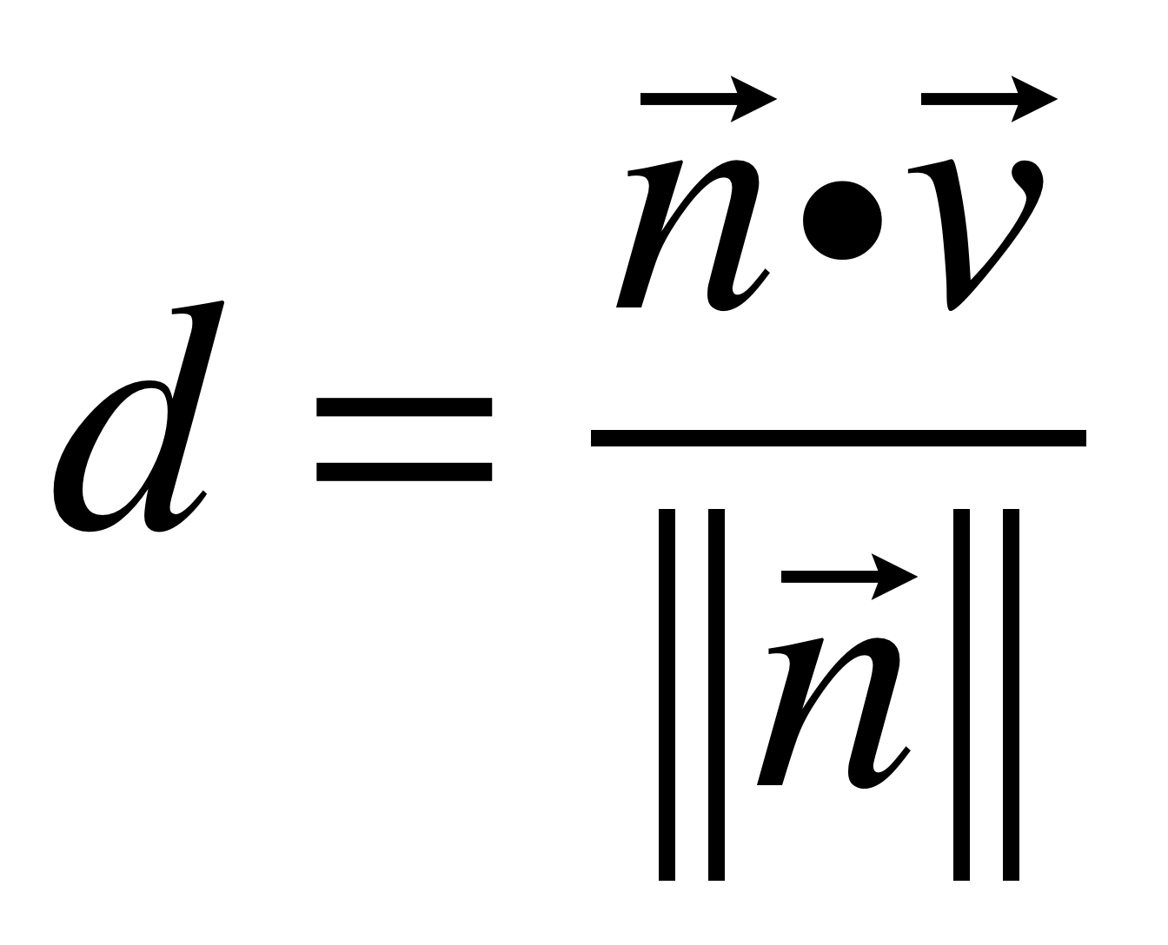
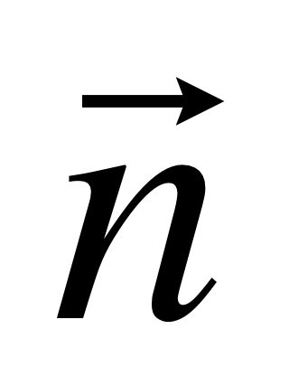
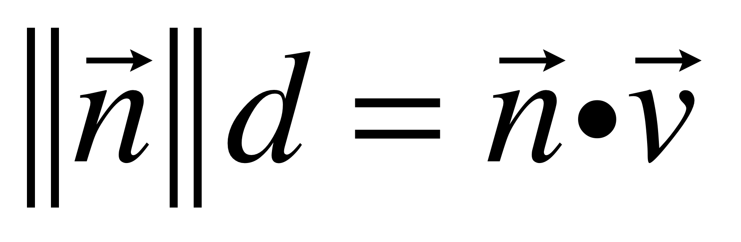
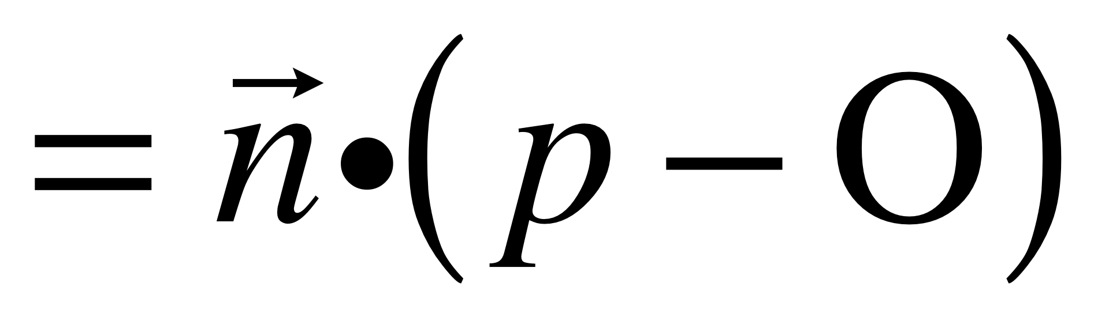
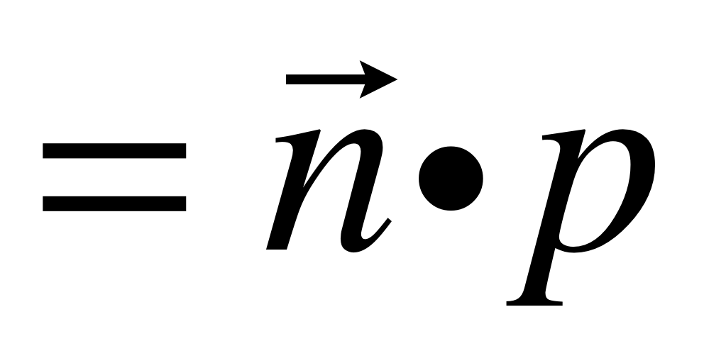



Normal Form
d
O
d is the distance from the origin to the line
What is d?
c is the distance scaled by the length of the normal

Slide 11
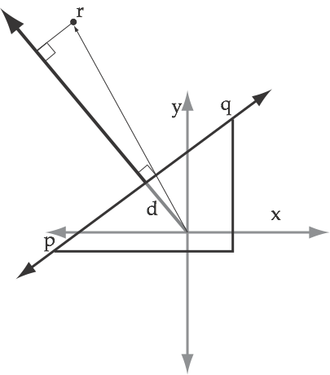
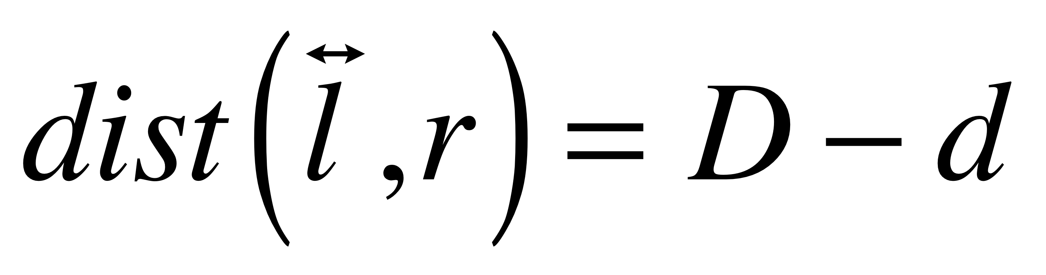
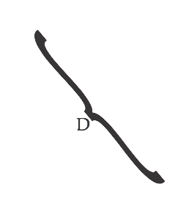
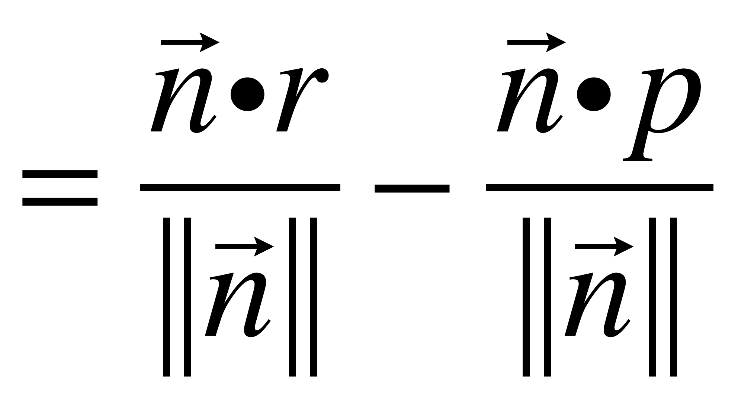
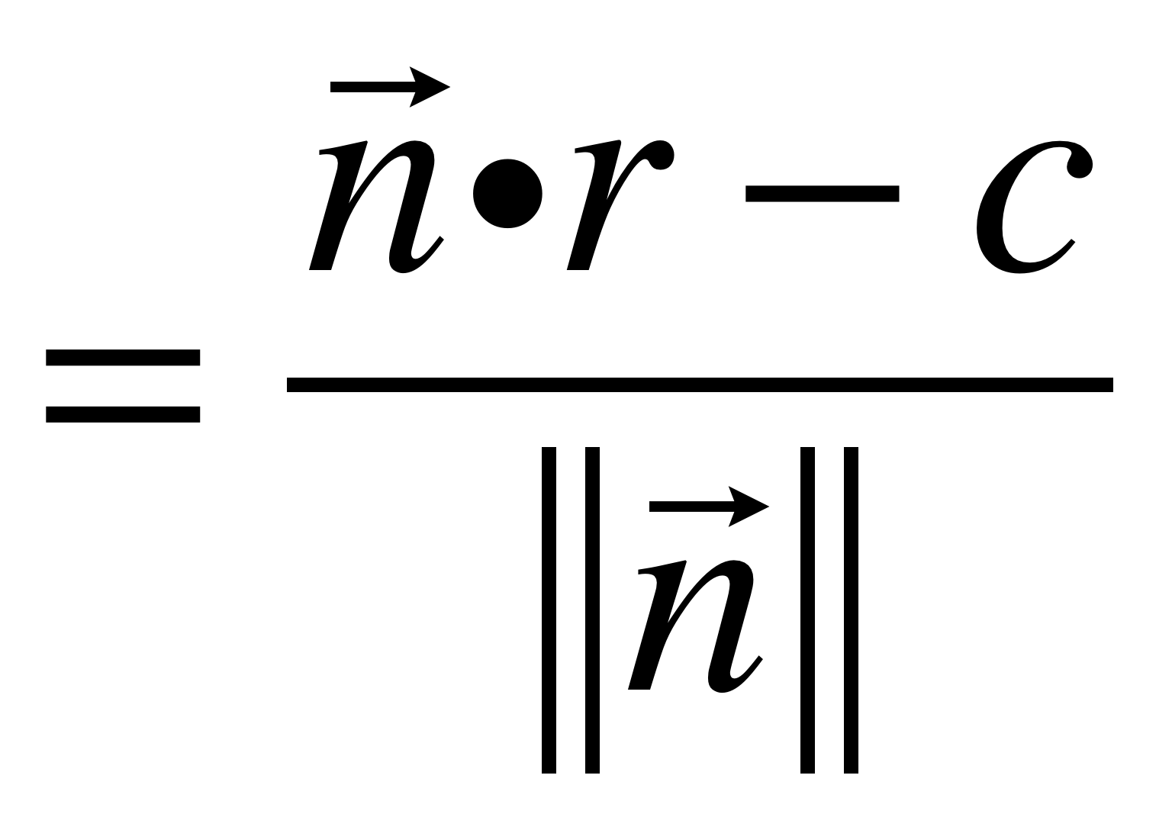
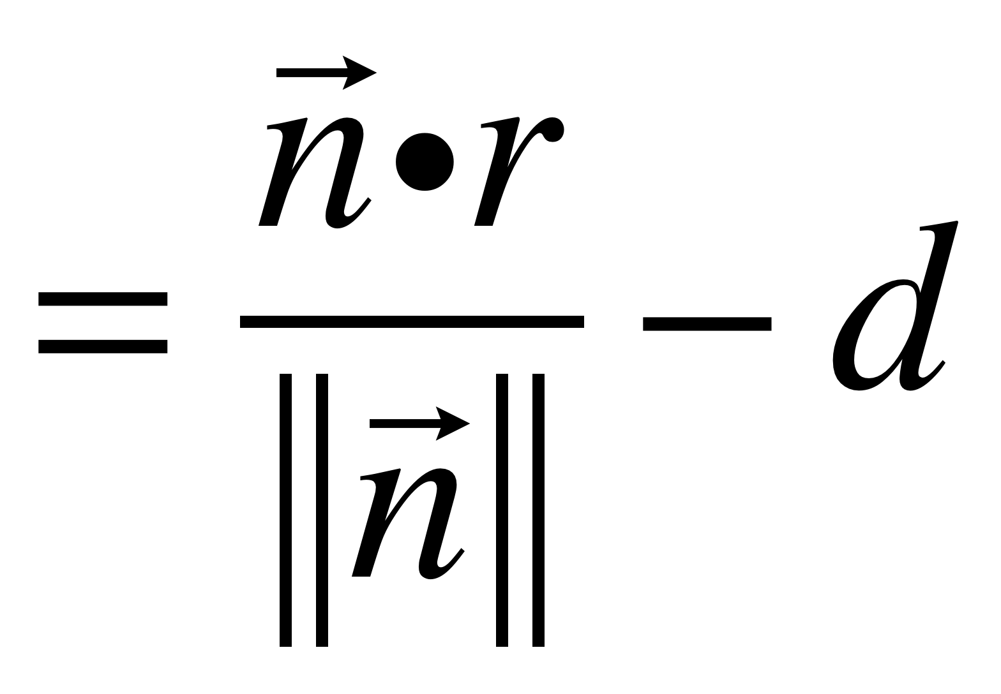
Distance From A Line

Slide 12
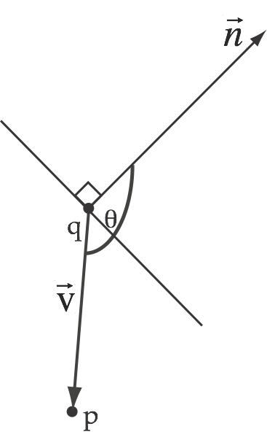
Which side of a line
Testing which side a point is on is easy with the normal form
+: in direction of normal
0: on line
-: away from normal
Notes:
Distance to p from line given by last slide. The size of the projection from v over n is the result of the dot product between them, which also means the angle.
Long story short, dot product gives us the signal.

Slide 13
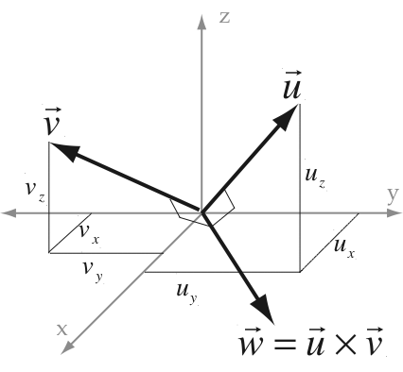
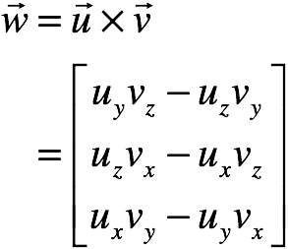
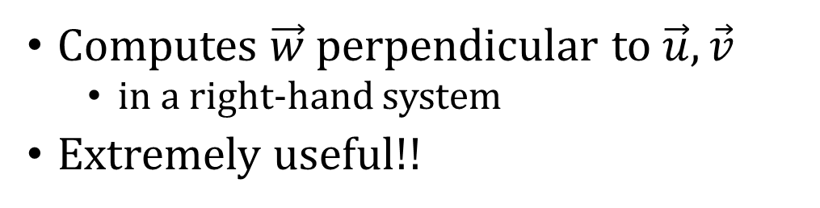
Cross-Product
Computes $\vec{w}$perpendicular to $\vec{u},\vec{v}$
in a right-hand system
Extremely useful!!

Slide 14
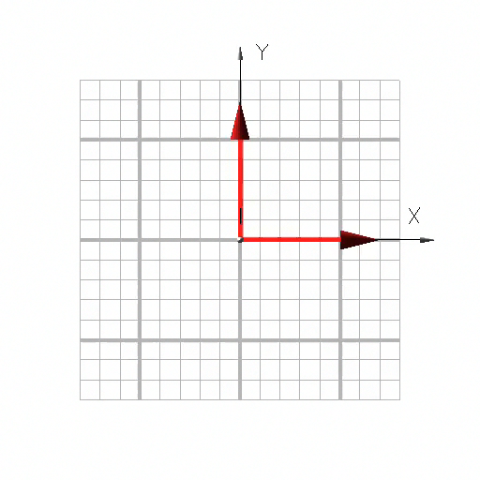
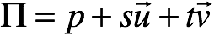
Parametric Plane Equation
p is any point in ∏
u, v are any two independent vectors in ∏

Slide 15
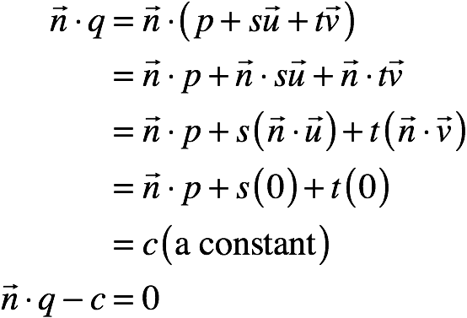
Normal Form of Plane
Find n = u × v (the cross-product)
Perpendicular to the plane
Notes:
Just need normal and two points in the plane, p and q. (c = n.p)

Slide 16
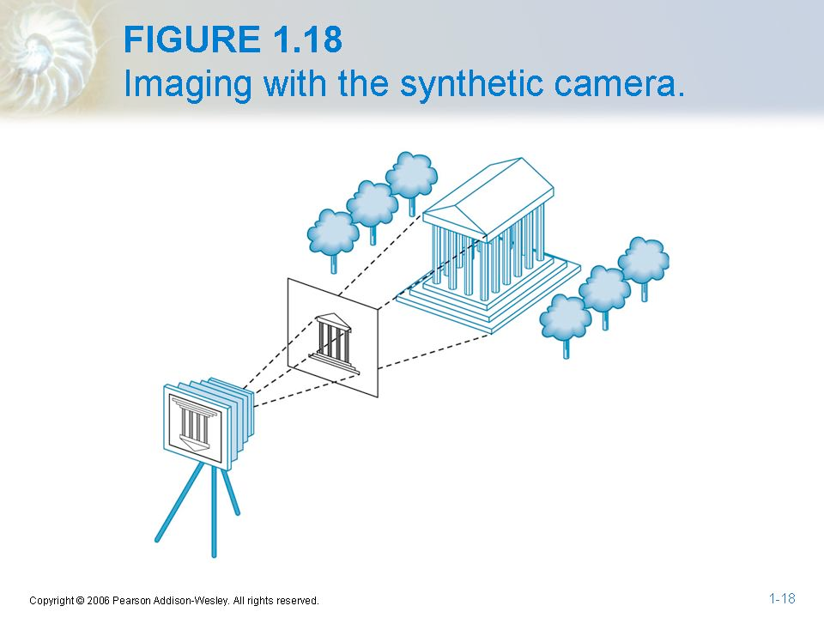
The Synthetic Camera

Slide 17
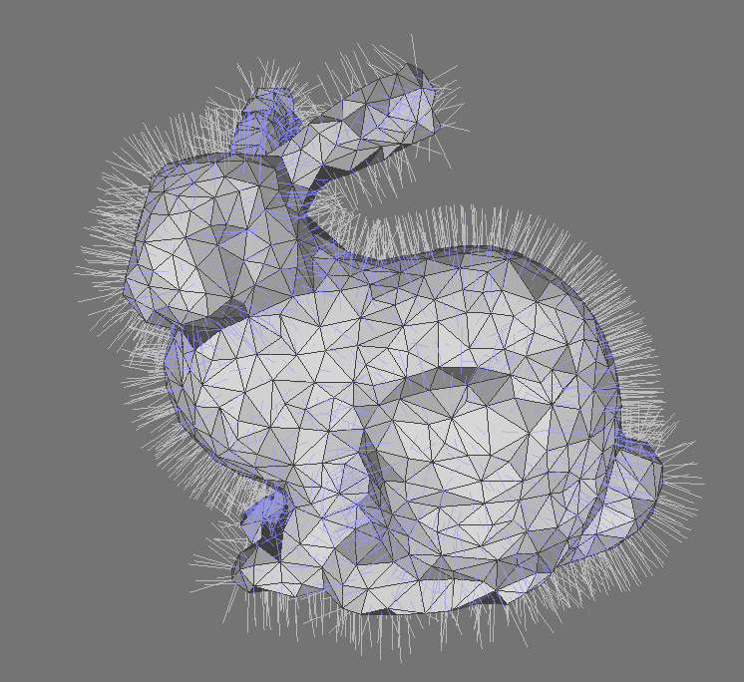
Assume we have:
A triangle mesh M, with:
Vertex positions
Vertex normals
Texture coordinates (& a texture)
An eye E
An image plane Π made up of pixels

Slide 18
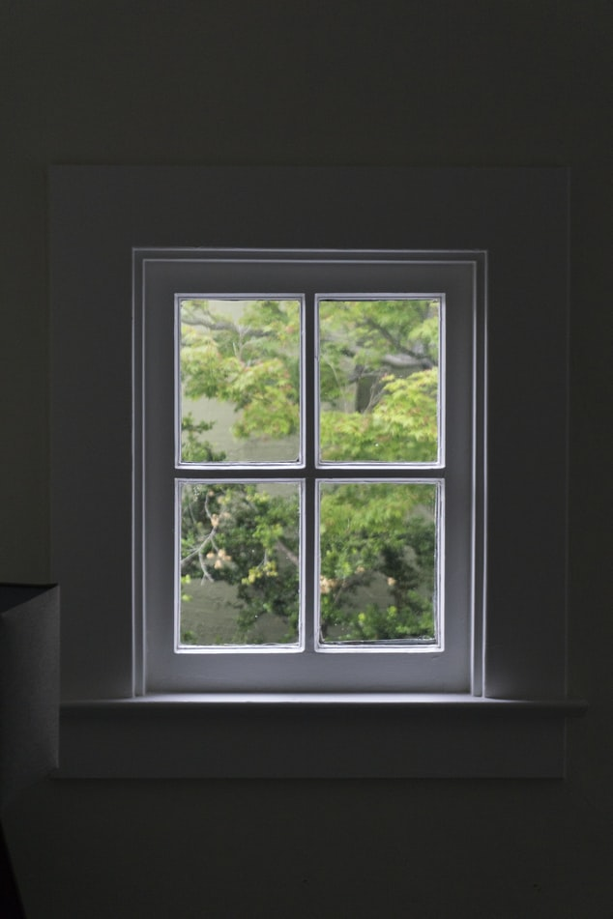
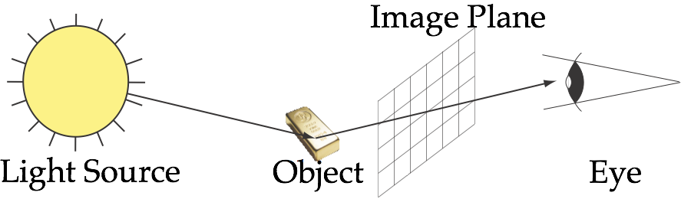
Alberti’s Window
Place glass sheet in front of the eye
Draw what you see on the glass sheet
Then take the sheet with you

Slide 19
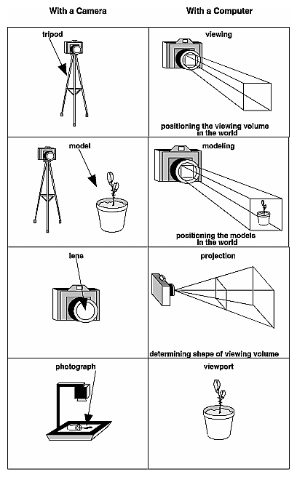
Synthetic Camera
Use Geometry to Place Camera
(View Transformation)
Use Geometry to Place Models
(Model Transformation)
Use Projection to Describe Camera
(Projection Transformation)
Use Projection to Describe Screen
(Viewport Transformation)

Slide 20


Coordinate Systems
OCS is the Object Coordinate System
WCS is the World Coordinate System
VCS is the View Coordinate System
CCS is the Clipping Coordinate System
NDCS is the Normalized DCS
DCS is the Device Coordinate System

Slide 21
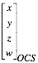
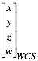
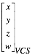
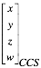
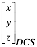
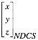
Why so many?
Object Model
World Model
View Model
Model
Matrix
View
Matrix
Actually makes our lives easier when representing a scene
Projection
Matrix
Perspective
Division
Viewport
Transformation
Clipping
Image Plane
Screen

Slide 22

Object Coordinate System
World Coordinate System

Slide 23
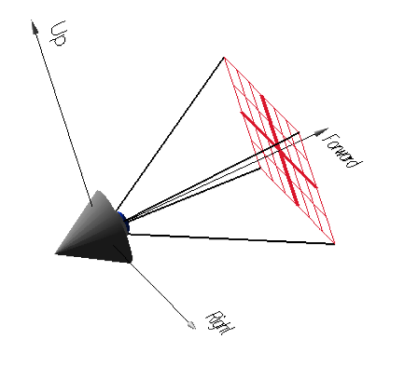
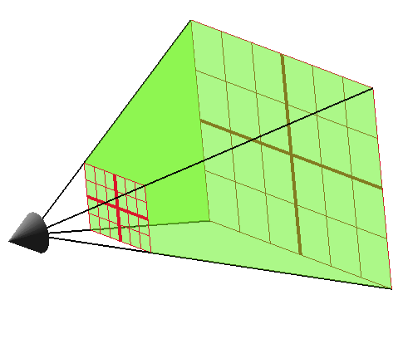
View Coordinates
Coordinates from camera’s viewpoint
Allows viewpoint to move in the world
Effectively, an extra rotation & translation
View Frustrum
For perspective, view volume is
a view frustum (a truncated pyramid)
For orthogonal, view volume is a box

Slide 24
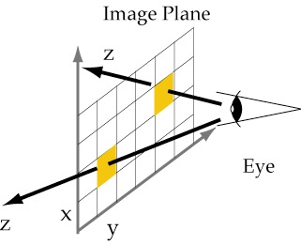
Clipping Coordinates
Point coordinates after perspective projection.
Projection: remember Alberti’s window.
They are “2D”, with z being the distance from the eye

Slide 25
Normalized DCS
Normalized Device Coordinate System
Divide CCS through by w
converts homogeneous coords to Cartesian
z will be used for z buffer
Independent of screen coordinates
I.e. range is [0,1]x[0,1]x[0,1]
Example:
(1.5, 1, -1, 1) --> (1.5, 1, -1 )
(1.5, 1, 0.2, 2) --> (0.75, 0.5, 0.1)
(3, 2, 0.2, 2) --> (1.5, 1, 0.1)

Slide 26
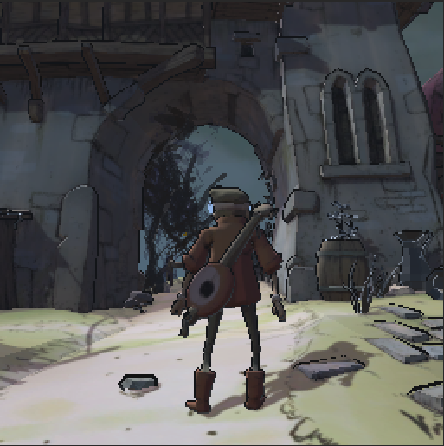
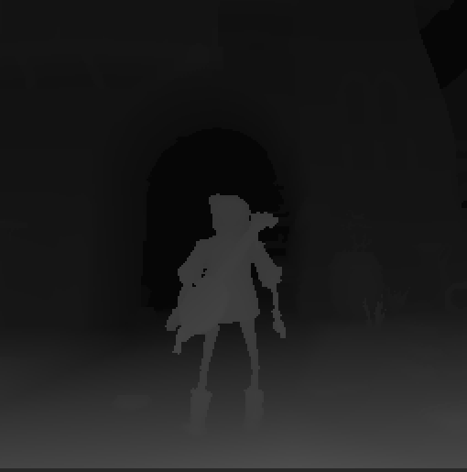
Device Coordinates (DCS)
Device coordinates are:
used for final render to screen
expressed in pixel coordinates
x, y: position on image plane, z: “depth” in front of image plane
normalised from [0..1] to [0..255] or [0..65536]

Slide 27

FF’s Biggest Mistake
Object Model
World Model
View Model
Model
Matrix
View
Matrix
Modelview Matrix
An optimization, but makes understanding the transformations more confusing.
Projection
Matrix
Perspective
Division
Viewport
Transformation
Clipping
Image Plane
Screen

Slide 28
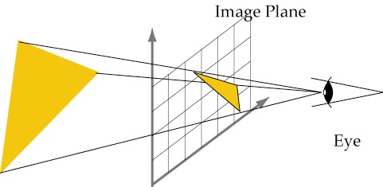
Projective Rendering
Fundamental trick behind video card
Project each triangle to image plane
Triangles always project as triangles
We need to rasterise (draw) lines & triangles

Slide 29
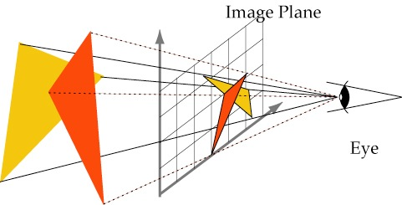
Painter’s Algorithm
If we draw objects from back to front
the back objects will be occluded
i.e. we will see only the front object
We have to sort all objects for each image

Slide 30
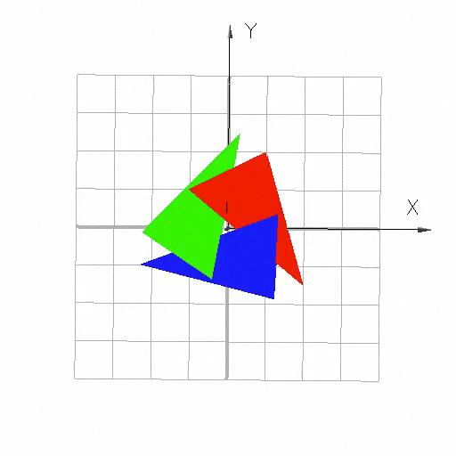
Worst Case
Three triangles
Red overlaps Green
Green overlaps Blue
Blue overlaps Red
Painter’s Algorithm fails!

Slide 31

Depth (Z-) Buffering
For each pixel, set Z = -∞
For each triangle
Transform to image coordinates
Rasterise to fragments - possible pixels
For each fragment (X, Y, Z, R, G, B)
If depth(X,Y) < Z, discard
Else depth(X,Y) = Z, colour(X,Y) = (R,G,B)

Slide 32

Projective Pipeline

Slide 33


State & Streams
Textures, matrices, render options, Vertex attributes are states!
State is applied to passing vertices
And must be changed explicitly
0.3 | 0.1 | 0.4 | 1.3 | …
0.4 | 1.1 | 1.3 | 1.2 | …
Input Stage
$$\left[\begin{matrix}1 & ⋯ & 0.4 \\ ⋮ & ⋱ & ⋮ \\ 3 & ⋯ & 0.5\end{matrix}\right]$$
Each set of vertices defines a primitive
Attributes are applied first
Optimisations come later on:
Vertex Arrays
Vertex Buffer Objects (VBOs)
Tessellation (in CPU library)

Slide 34
Geometry Stage
Geometric transformations are applied
Using homogeneous matrices
Lighting calculated per vertex
Gives one colour per vertex
Colours interpolated during rasterization
Programmable with vertex shaders, &c.
Vertices cached for later reuse

Slide 35

Rasterisation Stage
Primitives are rasterised into fragments
Barycentric coordinates are computed
Attributes are interpolated:
colour after lighting
texture coordinates (later)
depth
Not yet programmable with shaders

Slide 36

Fragment Processing
Each fragment is now processed separately
in parallel
textures are computed
depth and other tests performed
to see if we keep the fragment
fragment is written to output image
Programmable with fragment shaders

Slide 37

1st Gen Hardware - Fixed Function Pipeline
This is the original hardware design
Each stage uses different processors
Now simulated by GP processors
Everything can be done in parallel (depth test must be atomic)
Deeply pipelined, massively parallel

Slide 38

Programmable Pipeline
Drop in replacements for particular stages
Vertex Shaders
Tessellation Control Shaders
Tessellation Evaluation Shaders
Geometry Shaders
Fragment Shaders
Compute Shaders

Slide 39
Evolved Pipeline
(Tessellation)
Vertex
Stream
Vertex
Shader
Rasteriser
Fragment
Stream
Geometry
Shader
Post Transform
Cache
Fragment
Shader
Depth Test
Image Input
Texture
Storage
Frame Buffer
Compute Shader

Slide 40
Problems
What if we want to do things out of order?
E.g. do depth test before fragment shader
What if we want to preprocess all vertices?
Instead of using the post-transform cache
The pipeline model is breaking down
Progressively replaced by arbitrary compute
But still the basis of most libraries

Slide 41
Images by
S2 - Beazy@Unsplash
S9 - Kiran CK@Unsplash
S18 - Slrncl@Unsplash
S22 - Kaotaru@Unsplash
S31 - By -Zeus- - Own work, CC BY-SA 3.0, https://commons.wikimedia.org/w/index.php?curid=7355760
S33- By Drummyfish - Own work, CC0, https://commons.wikimedia.org/w/index.php?curid=76755935

